Slide 1
SHARING INFORMATION ON PROGRESS (SIP) APRIL 2020
Onitsha Business School

Slide 2
STATEMENT OF RENEWED COMMITMENT
Once again we at Onitsha Business School restate our commitment to the Principles of responsible Management Education. We have always focused in our teaching, learning and research, on how our principles, procedures and practices can impart society, especially our immediate society in such fashion as to bring about growth in modern responsible business and ethical practices; Visible improvement in human and infrastructural resources for the common good of society and sustainability of the businesses.

Slide 3
This progress report of Onitsha Business School describes activities/developments in 2019. The activities reported in it are true and correct. Onitsha Business School continues to support the objectives of the UN Principles for Responsible Management Education. We believe that the PRME six principles are essential for the development not only of the students and lecturers, but also for society at large. The significance of these principles is still increasing towards improvement in the field of corporate responsibility and sustainability.
Sylvanus Izebhokhae
Registrar

Slide 4
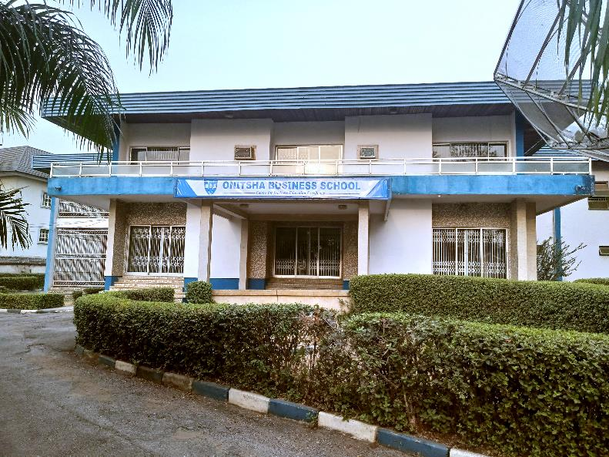

Slide 5
About Onitsha Business School
Onitsha Business School (OBS), is an internationally recognised business school located in Onitsha, Anambra State, Nigeria that provides professionals, executives and business people with professional and management education across the public and private sectors. OBS will strive to maintain a strong emphasis on professionalism and high ethical standards. The motivation is to develop a new crop of responsible executives and leaders to meet the growing demand for competent and quality leaders of thought in both public and private sectors across the country and globally.

Slide 6
Its services encompasses but not limited to the following:
Facilitation of Professional Certificate Courses
Facilitation of Seminars and Workshops
Tuition support for Executive MBA, MBA and Doctorate programs
Policy development
Consultancy Services
International Research Centre
OBS in its drive to be the leading global business school has developed partnerships with international and local business schools

Slide 7
VISION
To be the reference point for business education in Africa.
MISSION
To discover, develop and deploy appropriately human resources and allied competencies required for business development and support, delivered by well trained and highly motivated work force, employing contemporary methodology to generate superior returns and ensure adequate added value to students and the business community.
CORE VALUES
Leadership
Integrity
Knowledge
Professionalism

Slide 8
Program
Chartered Institute of Procurement and Supply (CIPS)
Onitsha Business School offers the Chartered Institute of Procurement and Supply certifications from certificate to professional diploma levels ranging from:
1. Certificate in Procurement and Supply
2. Advanced Certificate in Procurement and Supply
3. Diploma in Procurement and Supply
4. Advanced Diploma in Procurement and Supply
5. Professional Diploma in Procurement and Supply

Slide 9
THE PRINCIPLES OF RESPONSIBLE MANAGEMENT EDUCATION

Slide 10
PURPOSE AND VALUES
Principle 1 | Purpose We will develop the capabilities of students to be future generators of sustainable value for business and society at large and to work for an inclusive and sustainable global economy.
Principle 2 |Values We will incorporate into our academic activities and curricula the values of global social responsibility as portrayed in international initiatives such as the United Nations Global Compact

Slide 11
Principle 3|Method
We will create educational frameworks, materials, processes and environments that enable effective learning experiences for responsible leadership.
Principle 4 |Research
We will engage in conceptual and empirical research that advances our understanding about the role, dynamics, and impact of corporations in the creation of sustainable social, environmental and economic value

Slide 12
Principle 5|Partnership
We will interact with managers of business corporations to extend our knowledge of their challenges in meeting social and environmental responsibilities and to explore jointly effective approaches to meeting these challenges.
Principle 6|Dialogue
We will facilitate and support dialog and debate among educators, students, business, government, consumers, media, civil society organizations and other interested groups and stakeholders on critical issues related to global social responsibility and sustainability.

Slide 13
Onitsha Business School engages in partnership and dialogue with stakeholders and participants of the corporate network for the development of learning environment, student knowledge, skills and opportunities. These links have been strengthened with engaging activities and actions. Stakeholders have taken part in conferences and workshops, given guest lectures at Onitsha Business School.

Slide 14
In August 2019, Onitsha Business School organized its fourth breakfast meeting in collaboration with Onitsha Chamber of Commerce, Mines and Industry at Onitsha, Anambra State in the Breakfast Series: Nigeria Economy Intelligence Estimate (NEIE) The topic for discussion was African Continental Free Trade Area (AFCTA): Prospects & Challenges. The breakfast meeting was attended by the business community in Anambra State, students and staff of Onitsha Business School.

Slide 15
PROJECT AND ACTIVITY
BY
STUDENTS AND STAFF

Slide 16
Project:
…a race of distinction

Slide 17
WHO WE ARE
Onitsha City Marathon™ (OCM) is an initiative developed to discover and harness sporting talents of the teeming youths of Onitsha, Anambra State, Nigeria and Africa at large and to showcase Onitsha City on the global map as a centre of sporting excellence. (www.onitshacitymarathon.com)
OCM is aimed at revolutionizing sports as a tool for Socio-Economic Development in Africa, and ultimately encourage young people to invest their energies in sports. OCM is an Annual Marathon that would run through Onitsha metropolis.

Slide 18
WHO WE ARE
The maiden edition was held on the 5th of October, 2019, and is open to all, including youths, journalists, and professional sports men and women.

Slide 19
VISION
To be the Undisputed Best Marathon (UBM) reference in Africa.

Slide 20
MISSION
To be a platform for discovering, developing and deploying the avalanche sporting energies within the host environment and Africa at large, adopting effective coordinating methodology and contemporary technology.

Slide 21
STRATEGIC IMPERATIVE
Purity of intent and sincerity of purpose.

Slide 22
OBJECTIVES
The projects aims:
To Organize a world class Marathon in Onitsha City
To place Onitsha City on the global map as a Centre of Sporting excellence.
To change the perception of Onitsha as a city known only for buying and selling to a Sporting City.
To develop, harness and showcase new (sports) talents and give an avenue for existing sports talents to show case their skills.

Slide 23
OBJECTIVES Cont’d
To act as a catalyst to revolutionize sports as a tool for Socio- Economic development in Onitsha metropolis.
To create value-added networks that would be catalyst for emerging new partnerships.
To encourage young people to invest their energies productively in sports.
To lead to the creation of three Sports Recreation Centres (SRC) within the City.
To promote sports tourism in Onitsha City.
To put the Marathon on the IAAF (International Association of Athletics Federation), Association of International Marathon Sports (AIMS) and other Athletics calendar.

Slide 24
OCM INITIATOR AND COORDINATOR:
Professor Olusegun Sogbesan is the Director General of Onitsha Business School and the initiator of the Onitsha City Marathon™. The idea of Onitsha City Marathon™ is a product of an MBA simulation class as a solution to the observed environmental challenge, in otherwise energetic and vibrant youth populace idling away.
Onitsha Business School is the coordinator of the Onitsha City Marathon™.

Slide 25
ECONOMIC IMPACT
Onitsha City Marathon™ has huge economic impact with high multiplier effect. The weekend of the race, weeks preceding the weekend and even weeks to follow shall continue to harvest the ripple effects of the marathon event. Over a thousand artisans shall be engaged to achieve this sports tourism event. Jobs shall be created for Onitsha residents and good money shall be earned.

Slide 26
ECONOMIC IMPACT Cont’d
About 1,000 welders shall be engaged in designing, fabricating and installing many metal works to be used for the marathon event (e.g. barriers, stages, make-shift stalls), etc.
Another 1,000 carpenters to be engaged to build Medical Aid Centres, Doping Centre, Stage for music concert, etc.
Not less than 300 tailors shall be engaged to sew the kits
for the athletes and officials.

Slide 27
ECONOMIC IMPACT Cont’d
Over 5,000 visitors shall be visiting Onitsha; that includes athletes, their managers, officials of AFN, IAAF, AIMS, scouts, advertisers, spectators, etc. This 5,000 new people in town shall amount to not less than 2,000 hotel rooms. 2,000 hotel rooms in one night across our city is great business. Onitsha hotel rooms range from ₦2,000 and ₦30,000.

Slide 28
ECONOMIC IMPACT Cont’d
500 Course-Marshals shall be engaged that weekend for a fee. Employing about 500 young people comes with its spiral effects.
Over 1,000 volunteers shall be engaged for the event. In effect, crime is taken off our streets weeks before the event and even weeks after the event as a result of the trainings scheduled for these young people to be engaged by the Onitsha City Marathon™.

Slide 29
ECONOMIC IMPACT Cont’d
As a result from the first year, about 200 professional athletes are expected to be produced from the marathon. And 200 professional athletes means economic empowerment to about 200 families.

Slide 30
REGISTRATION
The Onitsha City Marathon™ has been registered and approved by Onitsha North Local Government.

Slide 31
TRADE MARK
The Onitsha City Marathon™ has been trade marked by the Federal Ministry of Trade and Investment.

Slide 32
ENDORSEMENT
The Onitsha City Marathon™ has been endorsed and approved by Athletics Federation of Nigeria, Association of International Marathons & Distance Races(AIMS) and International Association of Athletics Federation (IAAF).

Slide 34
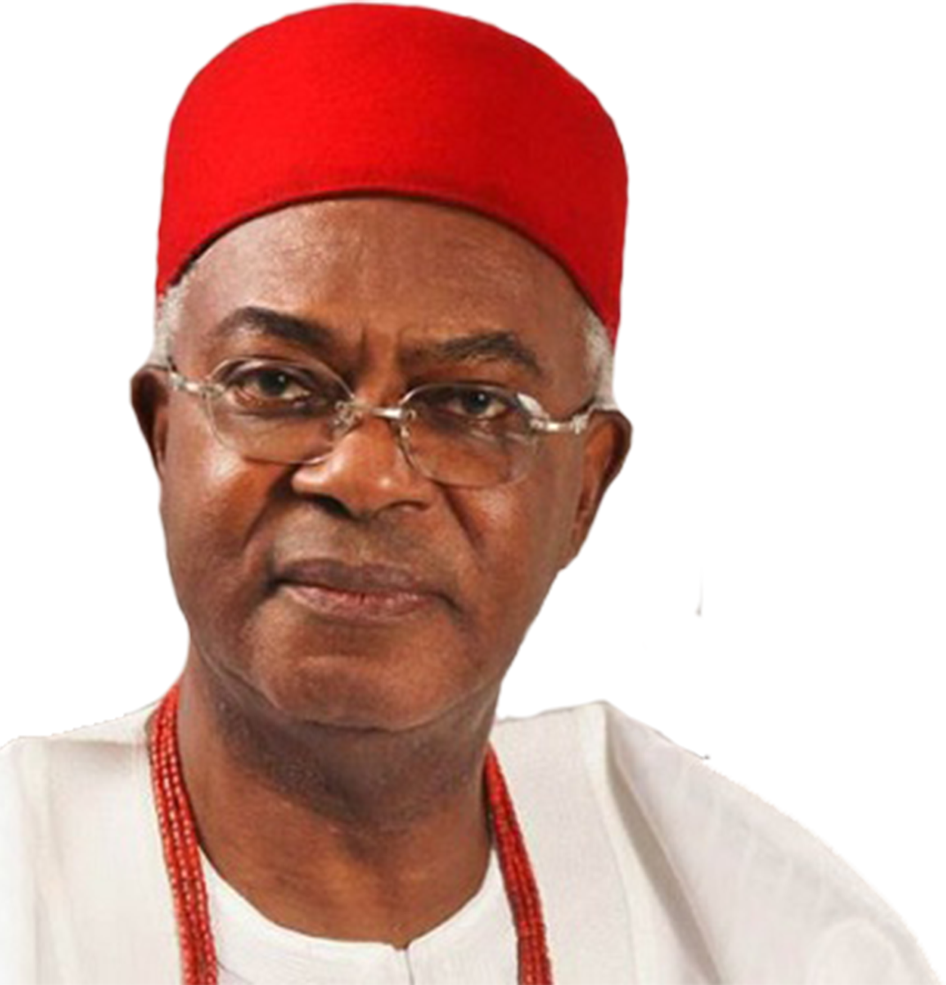
ENDORSEMENT
The Onitsha City Marathon™ has been endorsed and approved by the Obi of Onitsha, His Royal Majesty Igwe Nnaemeka Alfred Achebe CFR, mni (Agbogidi); and has been incorporated as part of the Onitsha annual Ofala Festival.

Slide 36
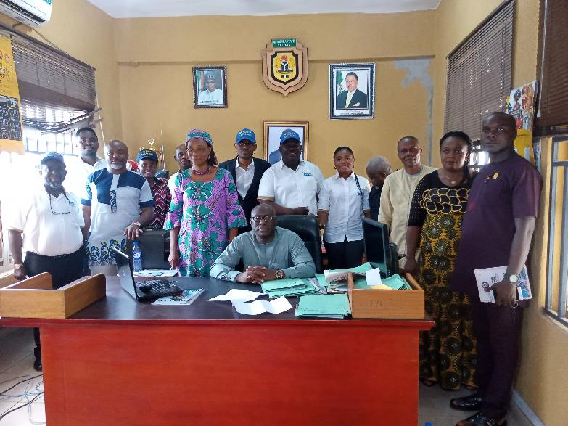

Slide 37
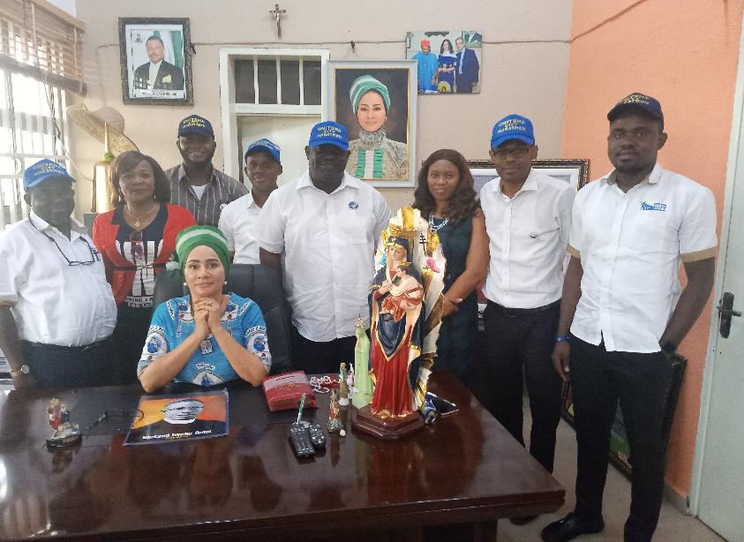

Slide 38
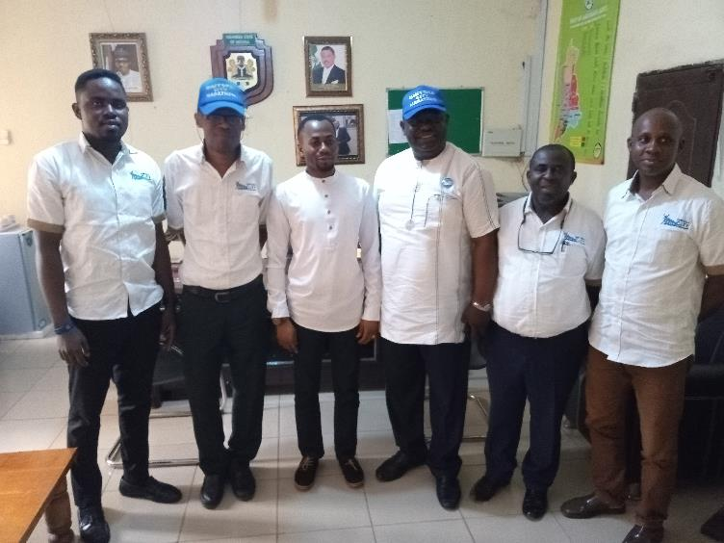

Slide 39
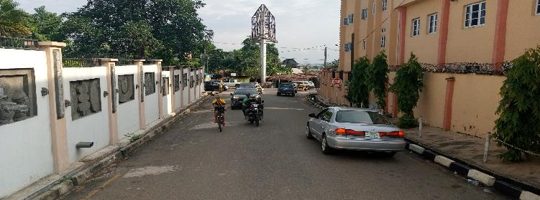

Slide 40
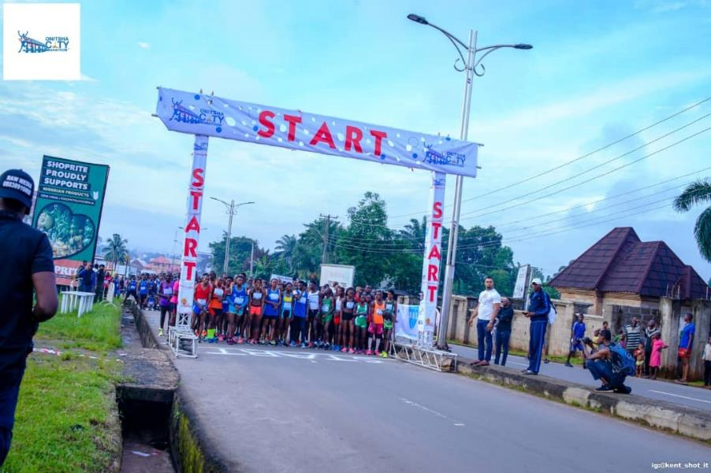

Slide 41
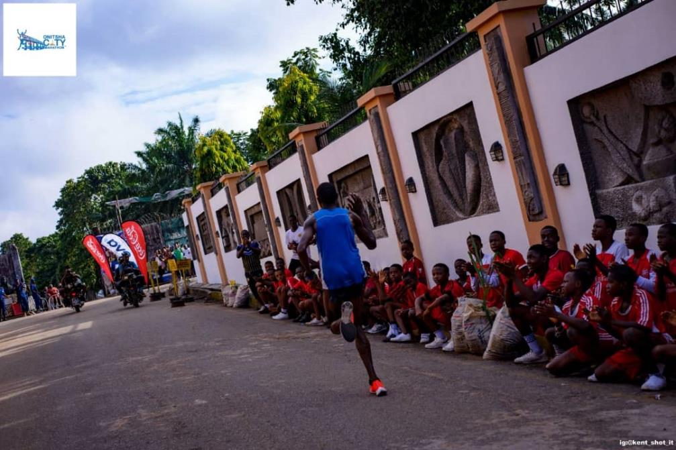

Slide 42
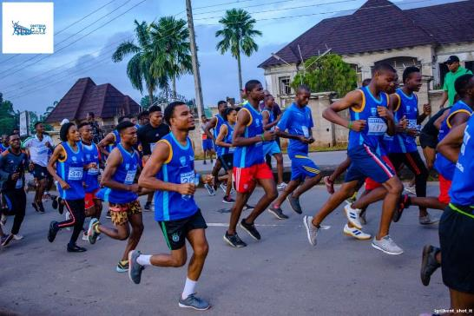

Slide 45
NIGERIAN EXPORTERS CONSORTIUM ( NEXCON)
The Nigerian Exporters Consortium (NEXCON) is another project developed from simulation in the EXPORT PROMOTION CLASS of the MBA program.
Business owners in the class who are into Manufacturing, Services provision and merchandizing came together in a consortium in alliance with some other businesses not part of the class for the purpose of carrying out export to other African countries.
The ship that exported made in Nigeria goods to Senegal via Onne port, Port harcourt left December 2019
www.nexconafrican.com

Slide 46
Future Perspectives
Sustainability and social responsibility will always be a fundamental part of Onitsha Business School. The School’s strategic objectives are to:
✓ continue to embed teaching and learning on responsibility and sustainability into the curriculum of its executive education programs.
✓ extend multi-disciplinary work through collaboration with other higher education institutions and enterprises
✓ extend teaching and learning activities that develop staff and students’ sustainability literacy and capabilities
✓further integrate the School’ research expertise
✓ identify new opportunities for improving the environmental performance

Slide 47
In the light of the above objective, the Marathon which has been registered by the School (Onitsha City Marathon) will continue as an annual programme with each new class of MBA/PHD improving on its content and reach.
Other programmes shall take up a project or two each year also from identified opportunities in the environment to improve its performance.

